Slide 1
Forwarding Programming in Protocol-Oblivious Instruction Set
Author : Jingzhou Yu, Xiaozhong Wang, Jian Song, Yuanming Zheng, Haoyu Song
Conference: 2014 IEEE 22nd International Conference on Network Protocols
Presenter: Tung-yin Chi
Date: 2015/8/12
Department of Computer Science and Information Engineering
National Cheng Kung University, Taiwan R.O.C.
Notes:
1

Slide 2
Paradigm Shift: From Black Box to White Box
SDN is about network programmability
Network programming ultimately requires device programming
  Policy deployment ≠ device programming
Use network device as a server
  Program network devices as needed by the application and then operate and control them

Slide 3
Open Programmable Network Device
Open programming interface
Diversified target platforms
CPU
NPU
FPGA
ASIC
performance
flexibility

Slide 4
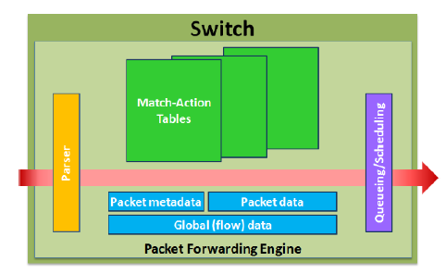
Abstract Forwarding Element Model
Match-Action Table (MAT) Pipeline is a good abstraction model
Network device programming is about defining the packet parser, tables, and the actions
Parser and actions can be programmed using a special instruction set – POF-FIS

Slide 5
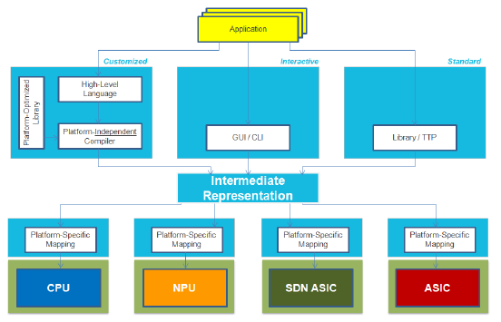
POF Programming Model

Slide 6
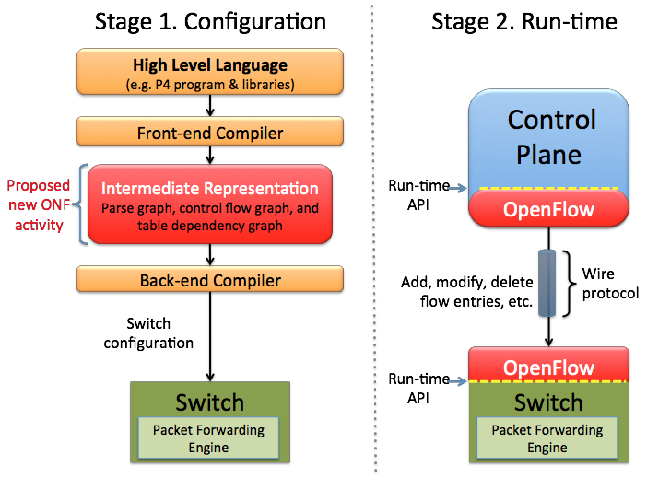
Protocol-Independent Programming Stages

Slide 7
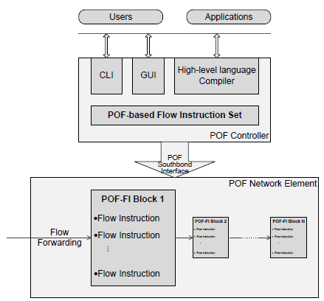
POF-FIS in POF Framework
Actions are programmed in instruction blocks
Actions are downloaded to NEs through POF south-bound interface
Actions can be dynamically or statically linked to flow entries

Slide 8
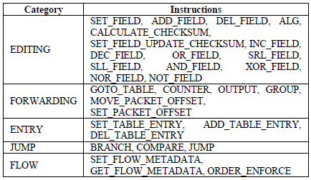
POF-FIS For Forwarding Abstraction
Packet parsing and editing
– Headers and fields are
identified by {offset, length}
Allow active and stateful data path processing
Flexible programming with control construction

Slide 9
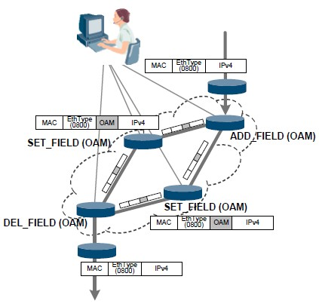
Use Case: POF-FIS for OAM
Insert a custom OAM field to packet header at ingress
Edit the OAM field in the
network
Remove the OAM field at
egress
OAM usage is programmable
  Performance
  Routing
  Statistics
Notes:
Operation Administration and Maintenance
(OAM)

Slide 10
Characteristic of POF-FIS
Flexibility
Independence
  North bound interface
  Service & Application
  Target platform
Completeness
  Any protocol
  Direct device programming at IR level

Slide 11
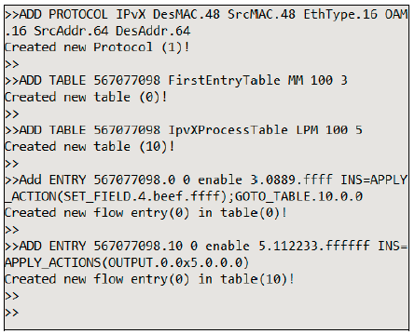
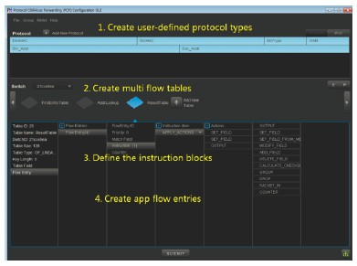
Implementation: GUI/CLI Programming Interface

Slide 12
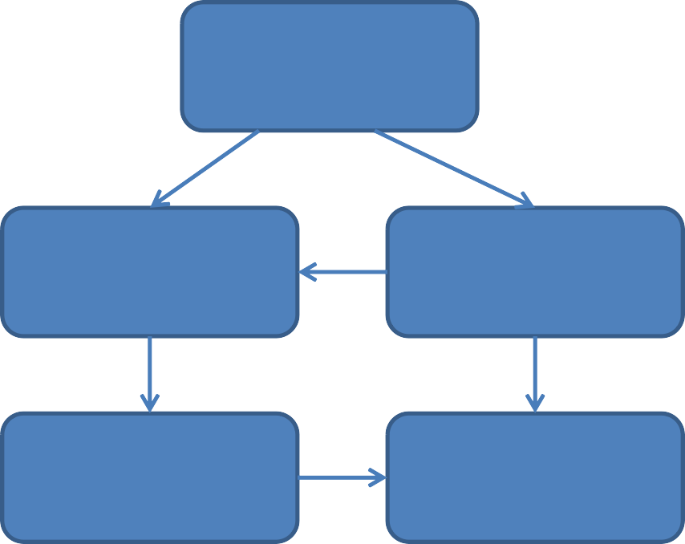
High Level Device Programming Languages
SDN
Programming
P4
  Optimized for hardware-based
  pipeline architecture
C/Java
  Enough mechanism for forwarding programming
    Struct, Class, ….
Network Programming Language
Policy
API
Device Programming Language
Config.
Runtime.
North Bound
Interface
South Bound
Interface

Slide 13
Conclusions
POF-FIS represents a self-contained forwarding abstraction
POF-FIS is the core components of the open network device programming IR
POF-FIS is neutral to high level programming languages and
target platforms
POF-FIS can become an important part of OpenFlow 2.0 standard

